Slide 1
Cloud Computing: Concepts, Technologies and Business Implications
Darshan University

Slide 2
Outline of the talk
Introduction to cloud context
  Technology context: multi-core, virtualization, 64-bit processors, parallel computing models, big-data storages…
  Cloud models: IaaS (Amazon AWS), PaaS (Microsoft Azure), SaaS (Google App Engine)
Demonstration of cloud capabilities
  Cloud models
  Data and Computing models: MapReduce
  Graph processing using amazon elastic mapreduce
A case-study of real business application of the cloud
Darshan University

Slide 3
Speakers’ Background in cloud computing
Bina:
  Has two current NSF (National Science Foundation of USA) awards related to cloud computing:
  2009-2012: Data-Intensive computing education: CCLI Phase 2: $250K
  2010-2012: Cloud-enabled Evolutionary Genetics Testbed: OCI-CI-TEAM: $250K
  Faculty at the CSE department at University at Buffalo.
Kumar:
  Principal Consultant at CTG
  Currently heading a large semantic technology business initiative that leverages cloud computing
  Adjunct Professor at School of Management, University at Buffalo.
Darshan University

Slide 4
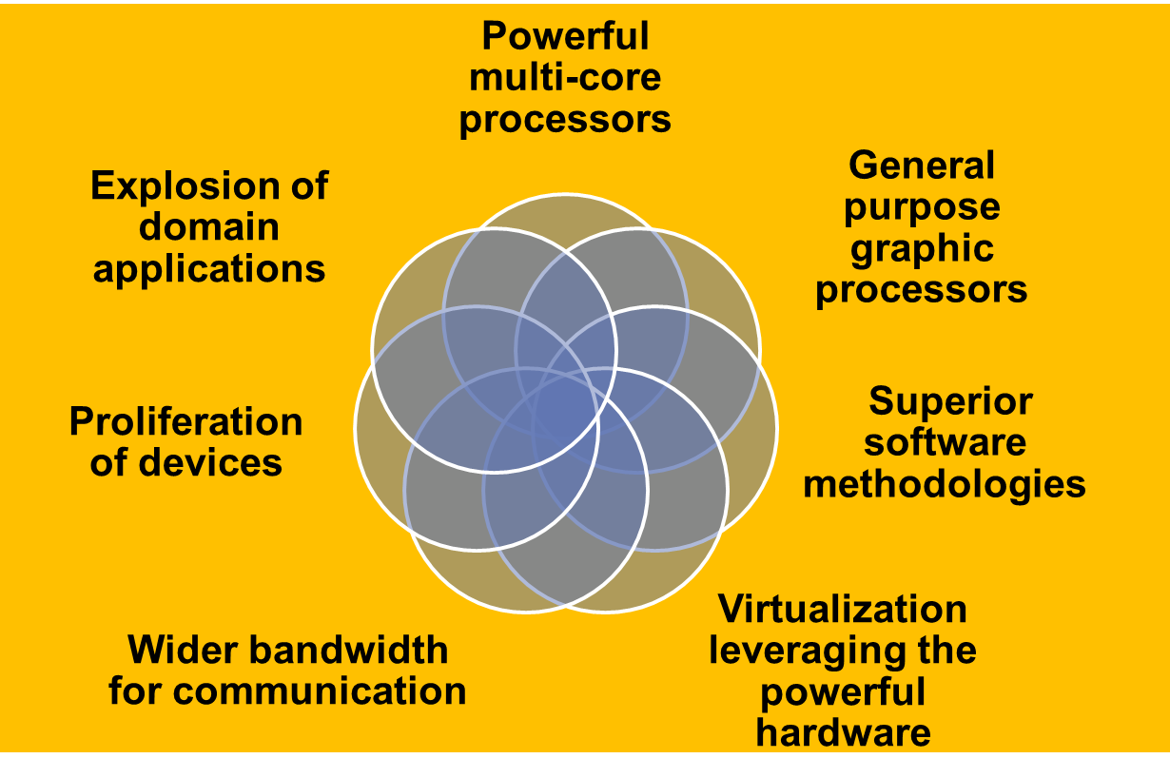
Introduction: A Golden Era in Computing
Darshan University

Slide 5

Evolution of Internet Computing
scale
web
Data-intensive
HPC, cloud
deep web
Semantic
discovery
Data marketplace and analytics
Social media and networking
Automate (discovery)
Discover (intelligence)
Transact
Integrate
Interact
Inform
Publish
time
Darshan University

Slide 6
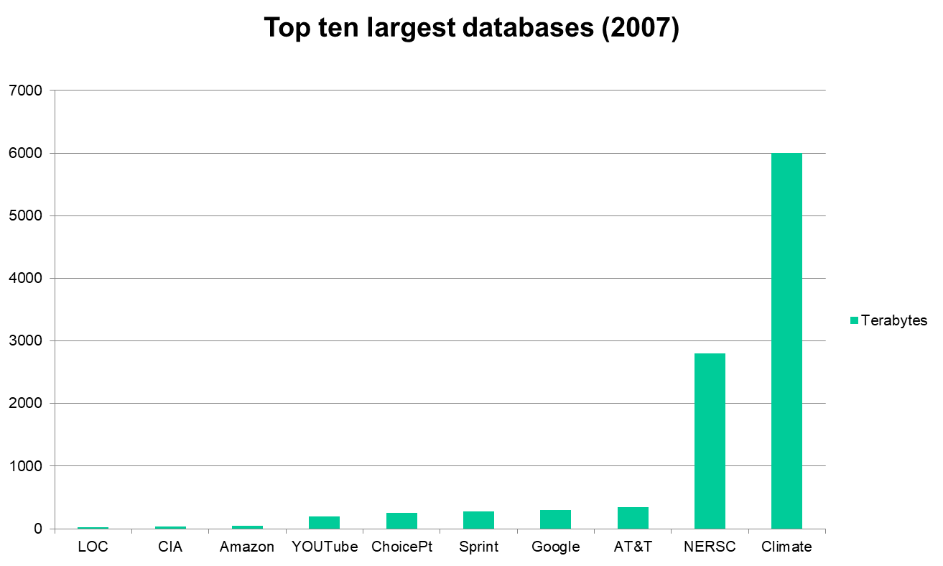
Top Ten Largest Databases
Darshan University

Slide 7
Enter the cloud
Cloud computing is Internet-based computing, whereby shared resources, software and information are provided to computers and other devices on-demand, like the electricity grid.
The cloud computing is a culmination of numerous attempts at large scale computing with seamless access to virtually limitless resources.
on-demand computing, utility computing, ubiquitous computing, autonomic computing, platform computing, edge computing, elastic computing, grid computing, …
Darshan University

Slide 8

“Grid Technology: A slide from my presentation to Industry (2005)
Emerging enabling technology.
Natural evolution of distributed systems and the Internet.
Middleware supporting network of systems to facilitate sharing, standardization and openness.
Infrastructure and application model dealing with sharing of compute cycles, data, storage and other resources.
Publicized by prominent industries as on-demand computing, utility computing, etc.
Move towards delivering “computing” to masses similar to other utilities (electricity and voice communication).”
Now,
Hmmm…sounds like the definition for cloud computing!!!!!
Darshan University

Slide 9
Answer: The Cloud Computing?
Typical requirements and models:
  platform (PaaS),
  software (SaaS),
  infrastructure (IaaS),
  Services-based application programming interface (API)
A cloud computing environment can provide one or more of these requirements for a cost
Pay as you go model of business
When using a public cloud the model is similar to renting a property than owning one.
An organization could also maintain a private cloud and/or use both.
Darshan University

Slide 10







Enabling Technologies
Cloud applications: data-intensive, compute-intensive, storage-intensive
Bandwidth
WS
Services interface
Web-services, SOA, WS standards
VM0
VM1
VMn
Storage Models: S3, BigTable, BlobStore, ...
Virtualization: bare metal, hypervisor. …
Multi-core architectures
64-bit processor
Darshan University

Slide 11
Common Features of Cloud Providers
Development
Environment: IDE, SDK, Plugins
Production
Environment
Simple
storage
Table Store <key, value>
Drives
Accessible through
Web services
Management Console and Monitoring tools
& multi-level security
Darshan University

Slide 12

Windows Azure
Enterprise-level on-demand capacity builder
Fabric of cycles and storage available on-request for a cost.
You have to use Azure API to work with the infrastructure offered by Microsoft
Significant features: web role, worker role , blob storage, table and drive-storage
Darshan University

Slide 13

Amazon EC2
Amazon EC2 is one large complex web service.
EC2 provided an API for instantiating computing instances with any of the operating systems supported.
It can facilitate computations through Amazon Machine Images (AMIs) for various other models.
Signature features: S3, Cloud Management Console, MapReduce Cloud, Amazon Machine Image (AMI).
Excellent distribution, load balancing, cloud monitoring tools.
Darshan University

Slide 14

Google App Engine
This is more a web interface for a development environment that offers a one stop facility for design, development and deployment Java and Python-based applications in Java, Go and Python.
Google offers the same reliability, availability and scalability at par with Google’s own applications .
Interface is software programming based.
Comprehensive programming platform irrespective of the size (small or large).
Signature features: templates and appspot, excellent monitoring and management console.
Darshan University

Slide 15
Demos
Amazon AWS: EC2 & S3 (among the many infrastructure services)
  Linux machine
  Windows machine
  A three-tier enterprise application
Google app Engine
  Eclipse plug-in for GAE
  Development and deployment of an application
Windows Azure
  Storage: blob store/container
  MS Visual Studio Azure development and production environment
Darshan University

Slide 16
Cloud Programming Models
Darshan University

Slide 17
HDFS Architecture
Namenode
Metadata(Name, replicas..)
(/home/foo/data,6. ..
Metadata ops
Client
Block ops
Read
Datanodes
Datanodes
B
replication
Blocks
Rack1
Write
Rack2
Client
Darshan University

Slide 18
Hadoop Distributed File System
HDFS Server
Master node
HDFS Client
Application
Local file system
Block size: 2K
Name Nodes
Block size: 128M
Replicated
Darshan University

Slide 19
Classes of problems “mapreducable”
Benchmark for comparing: Jim Gray’s challenge on data-intensive computing. Ex: “Sort”.
Google uses it for wordcount, adwords, pagerank, indexing data.
Simple algorithms such as grep, text-indexing, reverse indexing.
Bayesian classification: data mining domain.
Facebook uses it for various operations: demographics
Financial services use it for analytics.
Astronomy: Gaussian analysis for locating extra-terrestrial objects.
Expected to play a critical role in semantic web and in web 3.0.
Darshan University

Slide 20
Large scale data splits
Map <key, 1>
<key, value>pair
Reducers (say, Count)
Parse-hash
Count
P-0000
, count1
Parse-hash
Count
P-0001
, count2
Parse-hash
Count
P-0002
Parse-hash
,count3
Darshan University

Slide 21
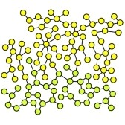
Demos
Word count application: a simple foundation for text-mining; with a small text corpus of inaugural speeches by US presidents
Graph analytics is the core of analytics involving linked structures (about 110 nodes): shortest path
Darshan University

